Slide 1

Decoding Chaos – User Guide
Last update: 31 March 2024

Slide 2
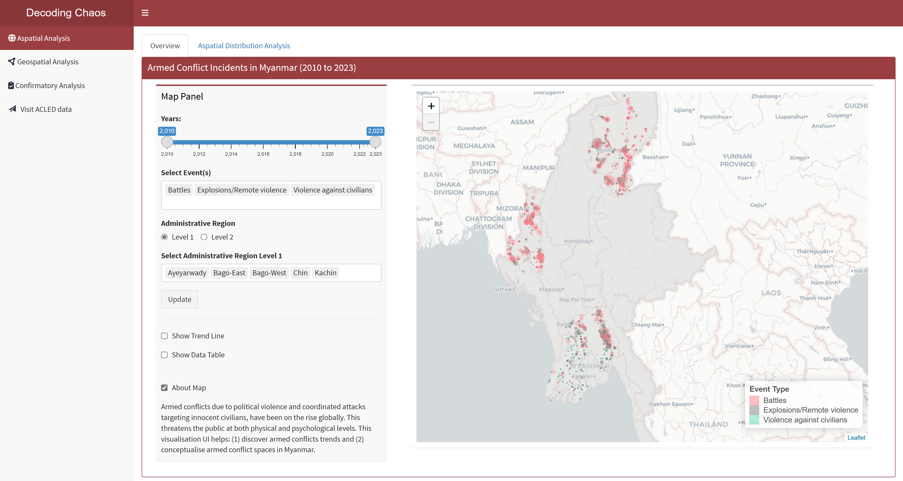
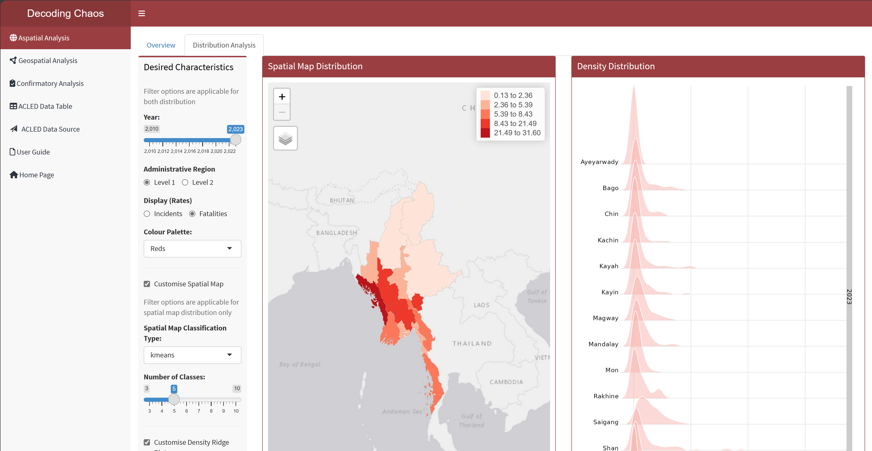
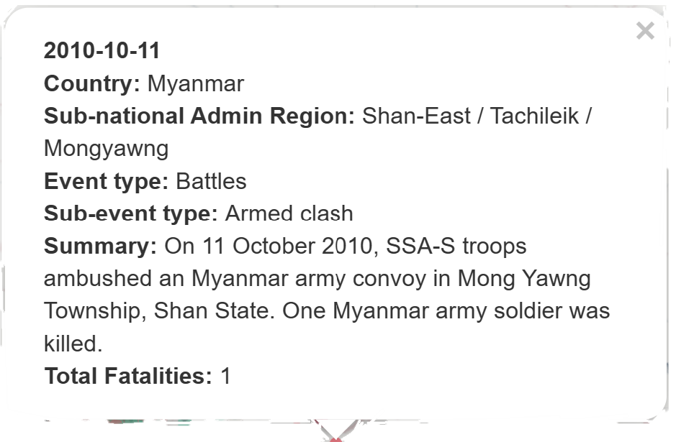
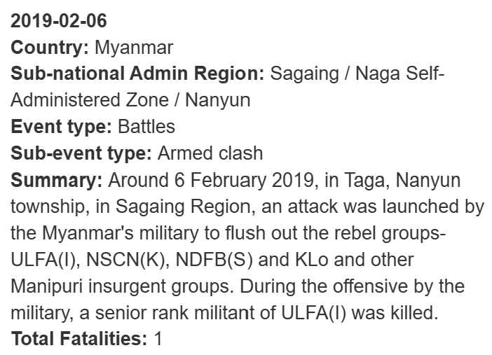
Aspatial Analysis – Overview
This page serves as the “landing page” that displays the map of Myanmar and its spatial points (proportional symbol based on fatalities) of armed conflicts over the years (i.e. 2010 to 2023). This visualisation UI helps: (1) discover armed conflicts trends and (2) conceptualise armed conflict spaces in Myanmar.
1) Options for Proportional Symbol Map (based on fatalities). Users can specify the parameters to plot the different armed conflict incidents on the map.
Users can specify a specific time-period.
Users can specify the specific event type(s) (allows multiple selection options with a maximum selection of 3).
Users can select the administrative region level.
Users can specify the administrative region (allows multiple selection options with a maximum selection of 5).
Users will need to select all the above and click on “Update” to render the map.
2) Pop-up box: Users can click on the incident points from the map. A pop-up box will display the armed conflict event information.
1
2
a
b
c
d

Slide 3
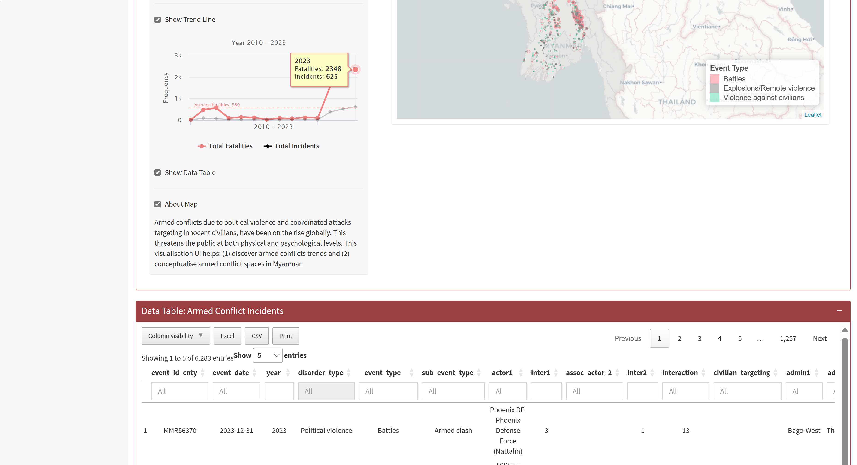
Aspatial Analysis – Overview (cont’d)
This page serves as the “landing page” that displays the map of Myanmar and its spatial points (proportional symbol based on fatalities) of armed conflicts over the years (i.e. 2010 to 2023). This visualisation UI helps: (1) discover armed conflicts trends and (2) conceptualise armed conflict spaces in Myanmar.
3) Trend Line: Users can select the check box to display trend line based on the selected parameters from the map. The trend line will be displayed below the checkbox selection.
4) Data Table: Users can select the check box to display datable based on the selected parameters from the map. The data table will be displayed below the map.
Users can select the columns that they are interested to view and hide the rest.
Users can download/ print dataset.
Users can specify the number of entries to display.
Users can search for a particular value or classification via the search box.
Users can sort each variable in ascending or descending order.
3
4
4
a
b
c
d
e

Slide 4
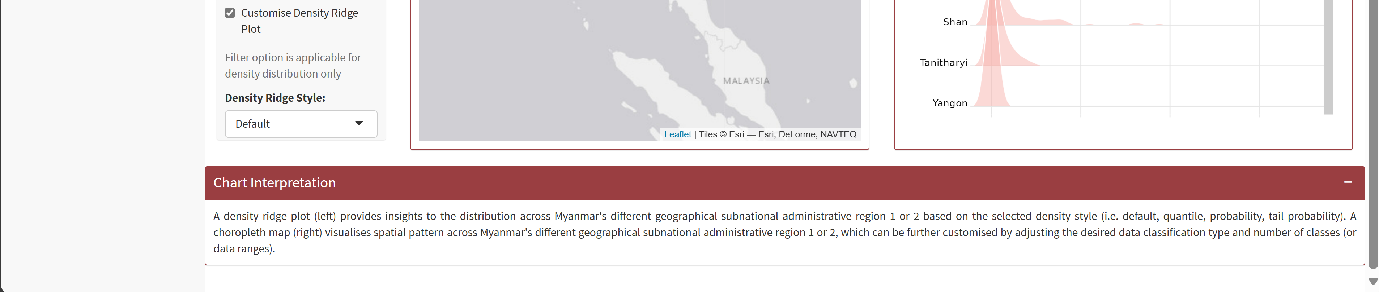
Aspatial Analysis – Distribution Analysis
This analysis page allows users to perform data visualisation to show the armed conflict incidents’ (and fatalities) spatial and density distribution represented in choropleth map and density ridge plot respectively.
1) Options for the two distribution plots (Choropleth Map and Density Ridge).
Users can specify the parameters.
Users can select year.
Users can select the administrative region level.
Users can select the rates (based on incident events or fatalities).
Users can select the colour palette to plot the choropleth map and density ridge plot. Note: Colour palette is only applicable to density ridge style (when set to default).
2) Customise Spatial Map: Users can select the check box to display additional parameters available to customise the choropleth map.
The additional custom parameters will be displayed.
Users can select the classification type (i.e. boxmap, equal, kmeans, pretty, quantile).
Users can select the number of classes to classify the data.
3) Customise Density Ridge Plot: Users can select the check box to display additional parameter available to customise the density ridge plot. The additional custom parameters will be displayed.
Users can select the style (i.e. Default, Quantile, Probability, Tail Probability)
Note: Colour palette is only applicable to density ridge style (when set to default).
1
a
b
c
d
2
a
b
3
a

Slide 5
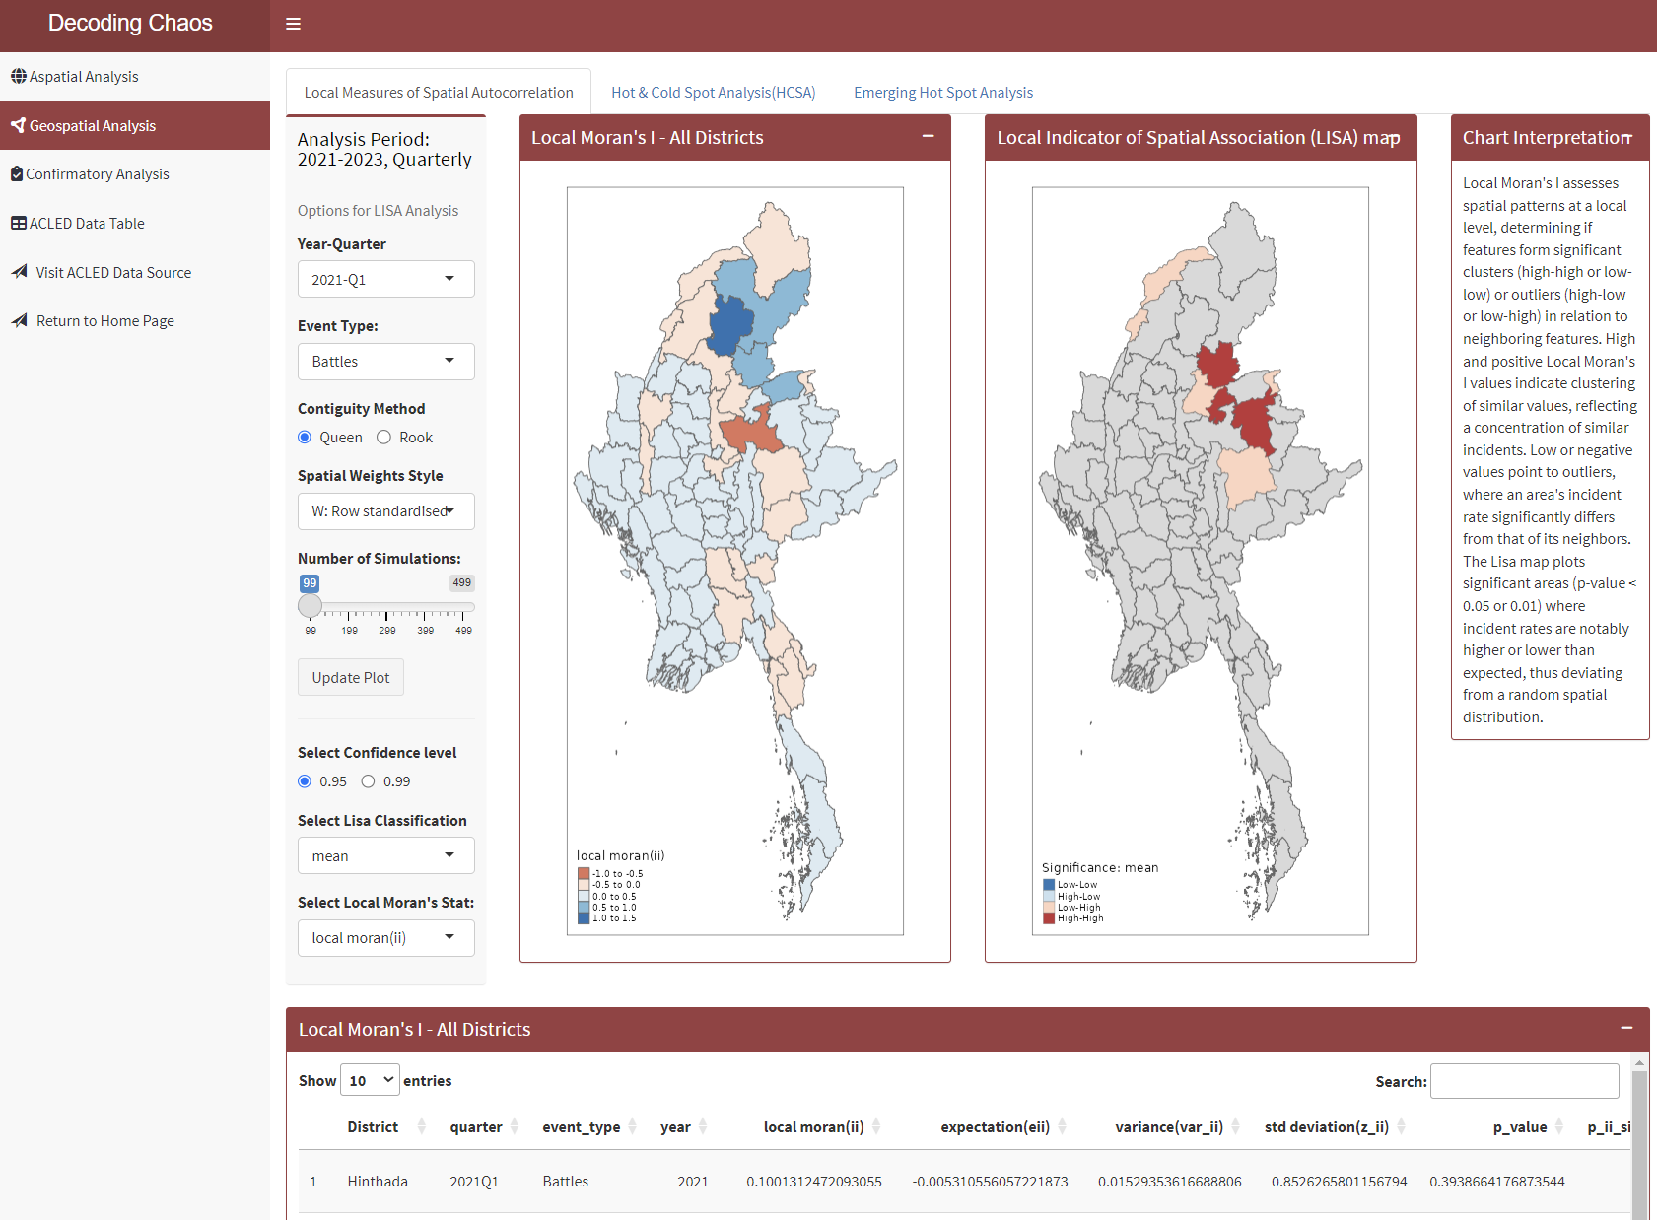
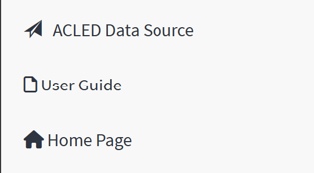
Geospatial Analysis – Local Measures of Spatial Autocorrelation
This analysis page allows users to perform a cluster and outlier analysis, to identify significant clusters of high and low values and outliers. Using the Local Moran’s I statistic, features are categorised into 2 clusters (High-High, Low-Low), 2 outliers (High-Low, Low-High) and 1 insignificant classes.
1) Options for LISA Analysis: Users can specify the parameters to calculate the Local Moran’s I statistics before rendering the choropleth maps and data table.
Users can specify a specific time- period.
Users can specify a specific event type.
Users can select the type of contiguity method to build a neighbours list.
Users can select the method to assign weights to neighbouring polygons.
Users can select the number of simulations to run.
Users will need to select all the above and click on “Update Plot” to render the maps and data table.
2) Choropleth map options: Users can specify the variables to display in both maps.
Users can specify the confidence level of the P-values to be shown in the LISA map.
Users can specify the type of significance to be shown in the LISA Map. (mean, median or pysal).
Users can select the Local Moran’s I statistic to be shown in the Local Moran’s I map.
3) Local Moran’s statistics for all Districts table.
Users can specify the number of entries to display
Users can search for a particular value or classification via the search box.
Users can sort each variable in ascending or descending order.
1
a
b
c
d
e
2
a
b
c
3
a
b
c

Slide 6
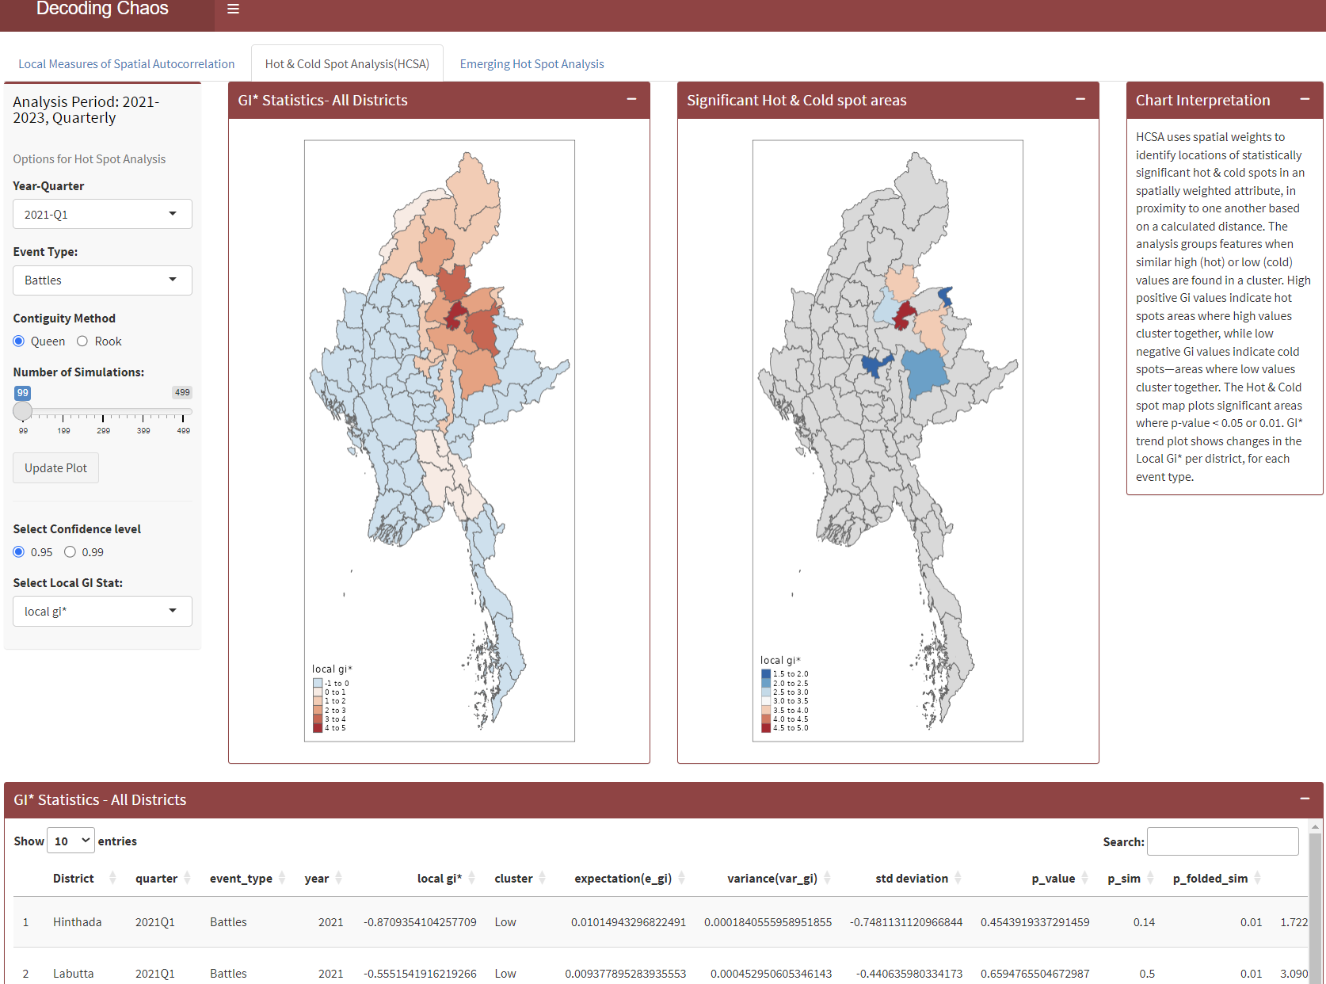
Geospatial Analysis – Hot & Cold Analysis
This analysis page allows users to perform a Hot & Cold Spot analysis, to identify significant areas of high and low values based on a calculated distance. Using the Getis-Ord Gi* statistic, features are grouped together when simila High (Hot) or Low (Cold) values are found in a cluster.
1) Options for Hot & Cold Spot Analysis: Users can specify the parameters to calculate the Getis-Gi* statistics before rendering the choropleth maps and data table.
Users can specify a specific time- period.
Users can specify a specific event type.
Users can select the type of contiguity method to build a neighbours list.
Users can select the number of simulations to run.
Users will need to select all the above and click on “Update Plot” to render the maps and data table.
2) Choropleth map options: Users can specify the variables to display in both maps.
Users can specify the confidence level of the P-values to be shown in the HCSA map.
Users can select the Gi* statistic to be shown in the Gi* Statistics map.
3) Gi* statistics for all Districts table.
Users can specify the number of entries to display
Users can search for a particular value or classification via the search box.
Users can sort each variable in ascending or descending order.
1
a
b
c
d
2
a
b
3
a
b
c

Slide 7
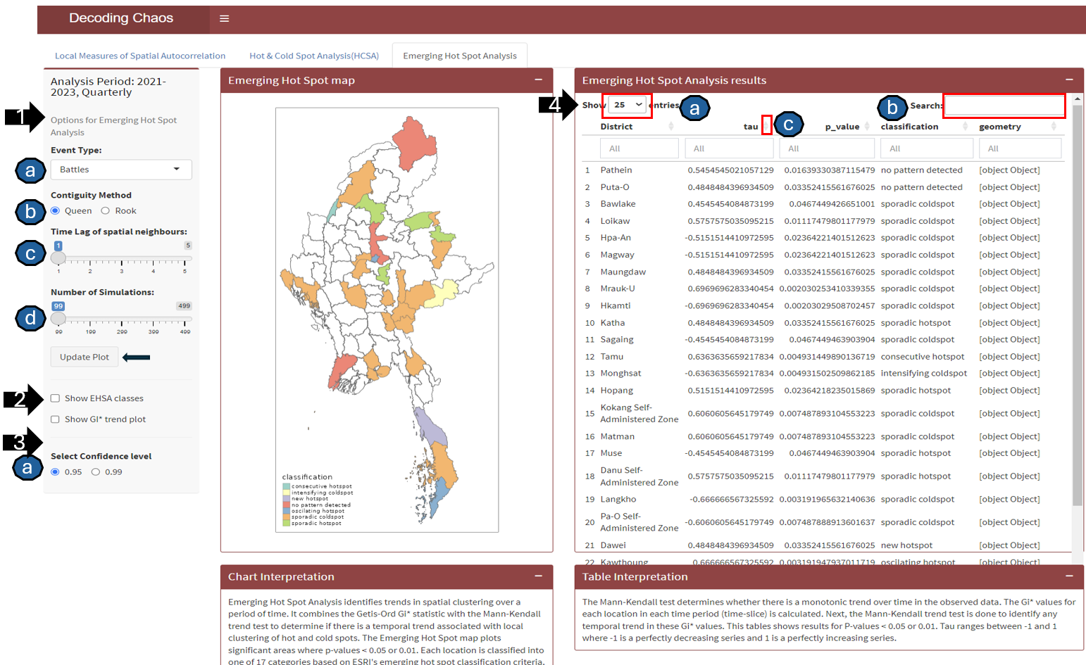
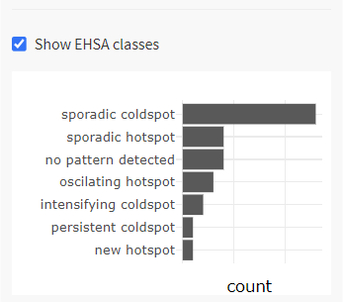
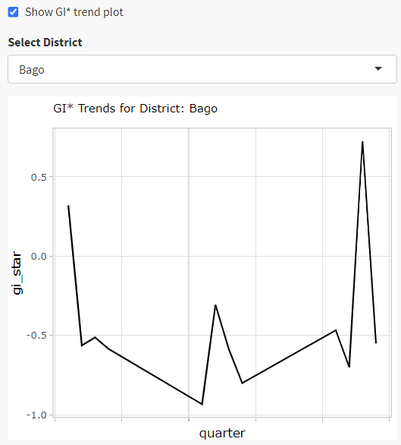
Geospatial Analysis – Emerging Hot Spot Analysis
This analysis page allows users to perform an Emerging Hot Spot analysis, to reveal and describe how hot spots and cold spots have changed over time. After identifying temporal trends, features are classified into one of 17 ESRI hot spot classifications.
2
Side-bar plots
1) Options for Emerging Hot Spot Analysis: Users can specify the parameters to calculate the analysis results before rendering the choropleth map and data table.
Users can specify a specific event type.
Users can select the type of contiguity method to build a neighbours list.
Users can select the number of time lags to include in the neighbourhood for calculating the local Gi*
Users can select the number of simulations to run to calculate the simulated p-values for the local Gi*.
Users will need to select all the above and click on “Update Plot” to render the map and data table.
2) Sidebar plots: Users can select the check boxes for EHSA classes and GI* Trend plot to render the 2 plots at the side bar.
3) Choropleth map options:
Users can specify the confidence level of the P-values to be shown in the Emerging Hot Spot map.
4) Emerging Hot Spot Analysis Results table.
Users can specify the number of entries to display
Users can search for a particular value or classification via the search box.
Users can sort each variable in ascending or descending order.

Slide 8
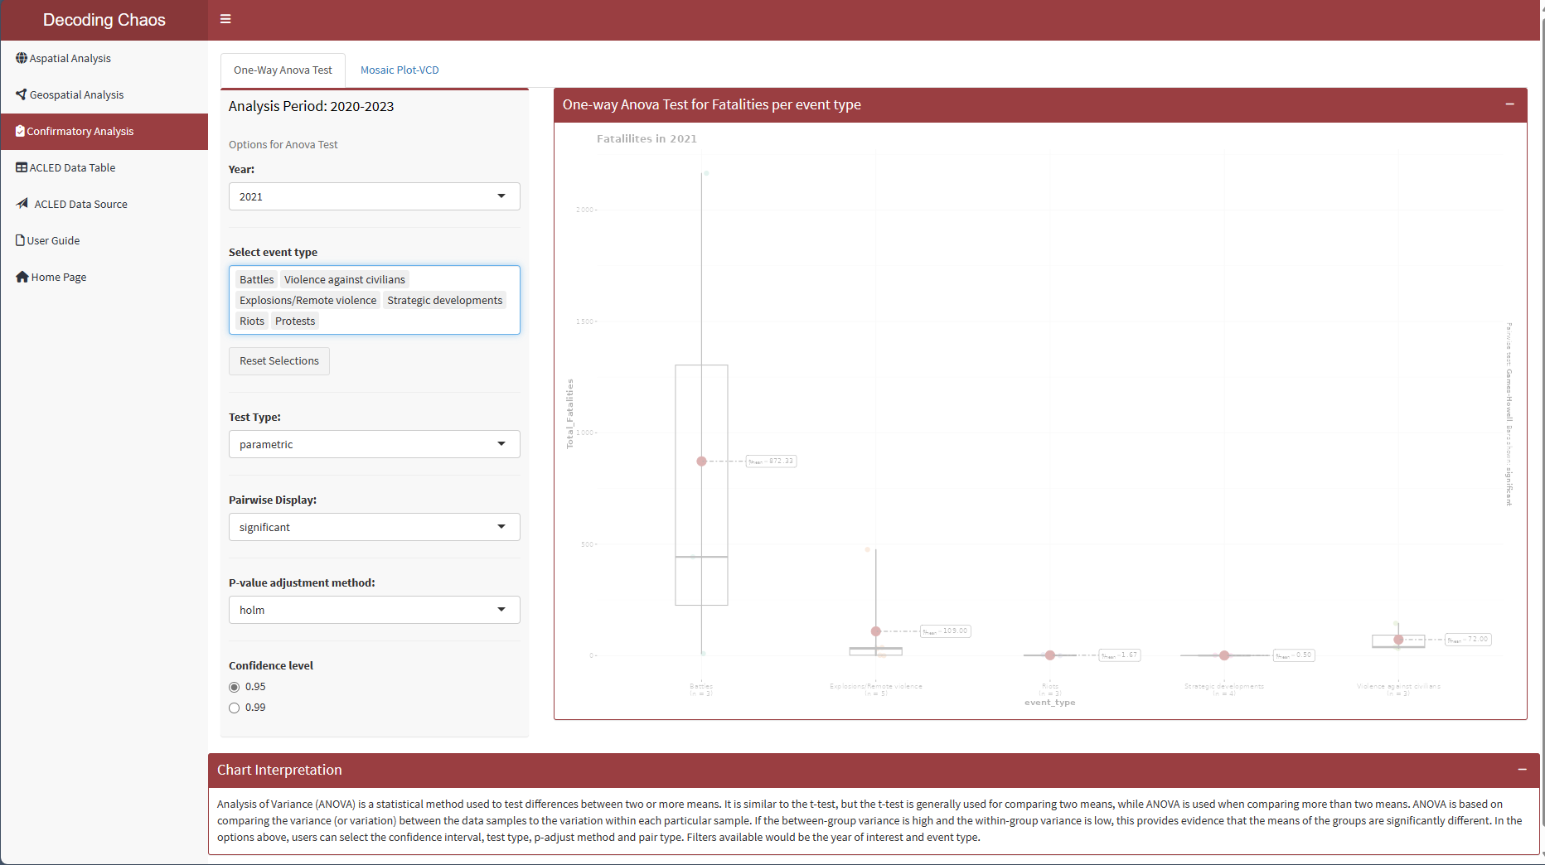
Confirmatory Analysis – One-Way ANOVA Test
This analysis page allows users to perform a One-Way ANOVA test to identify if there is any significant difference between the mean or median value for event types and the number of fatalities. If the p-value is below the critical value, it means that the null hypothesis has sufficient statistical evidence to support. Whereas if the p-value is above the critical value, the null hypothesis will be rejected due to insufficient statistical evidence.
1) Options for Anova Test: Users can specify the parameters that will be used during the calculation for Anova statistical test.
Users can select the year of interest between 2020 to 2023 to compare.
Users can multi-select the event types to compare between the various event types and their significance. Users can also click on the “Reset Selections” button if they want to start over.
Users can select the type of test they would like to use to calculate the statistics i.e. Parametric, Non-parametric, etc.
Users have the option to select on the type of pairwise display they would like to show on the plot i.e. Significant, Non-significant or all.
Users can select the type of P-value adjust method they would like to use during the statistical calculation.
Users can choose between 0.95 or 0.99 confidence interval to be used during the statistical calculation.
2) This section provides a brief explanation of what ANOVA testing is to the user.
1
a
b
c
d
e
f
2

Slide 9
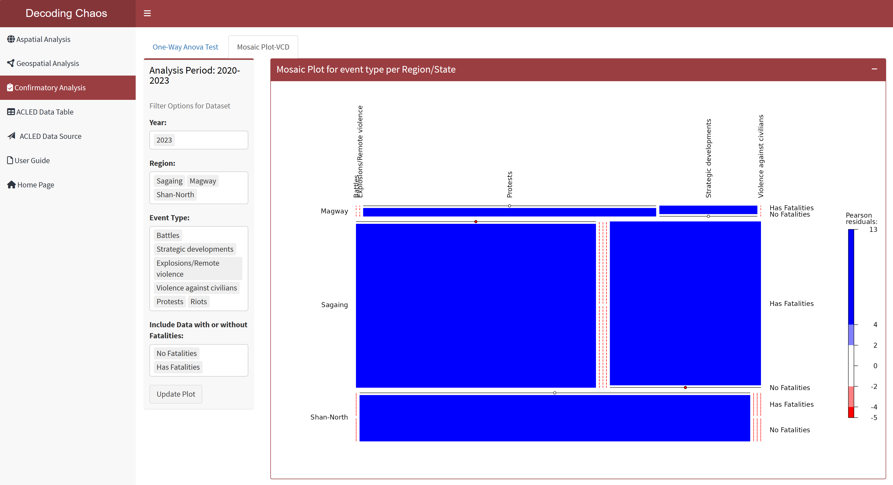
Confirmatory Analysis – Visualising Categorical Data
This analysis page allows users to visualise categorical data using mosaic plot to find association between the variables. The size of each tile would represent the proportion of observations for the variable. The colour of each tile would represent the residual where red tiles indicate significant negative residual where frequency is less than expected and blue tiles indicate significant positive residual where frequency is more than expected. The intensity of the colour represents the magnitude of the residuals which is shown on the legend on the right.
1) User can use the filter options further analyse the mosaic plot.
Users can select multiple years of interest ranging from 2010 to 2023.
Users can select multiple regions of interest to populate the mosaic plot. A minimum of 1 regions are required to be selected to display.
Users can select multiple event types to see if they are able to discover any association between them. A minimum of 2 event types are required to be selected to display as the mosaic plot is used to display proportionality of observations.
Users can select if they want to look at observations that only have fatalities, no fatalities or both.
Users will need to select all the above and click on “Update Plot” to render the plot.
2) This section provides users a brief explanation on how to interpret the mosaic plot and what the details on the chart mean.
1
a
b
c
d
2

Slide 10
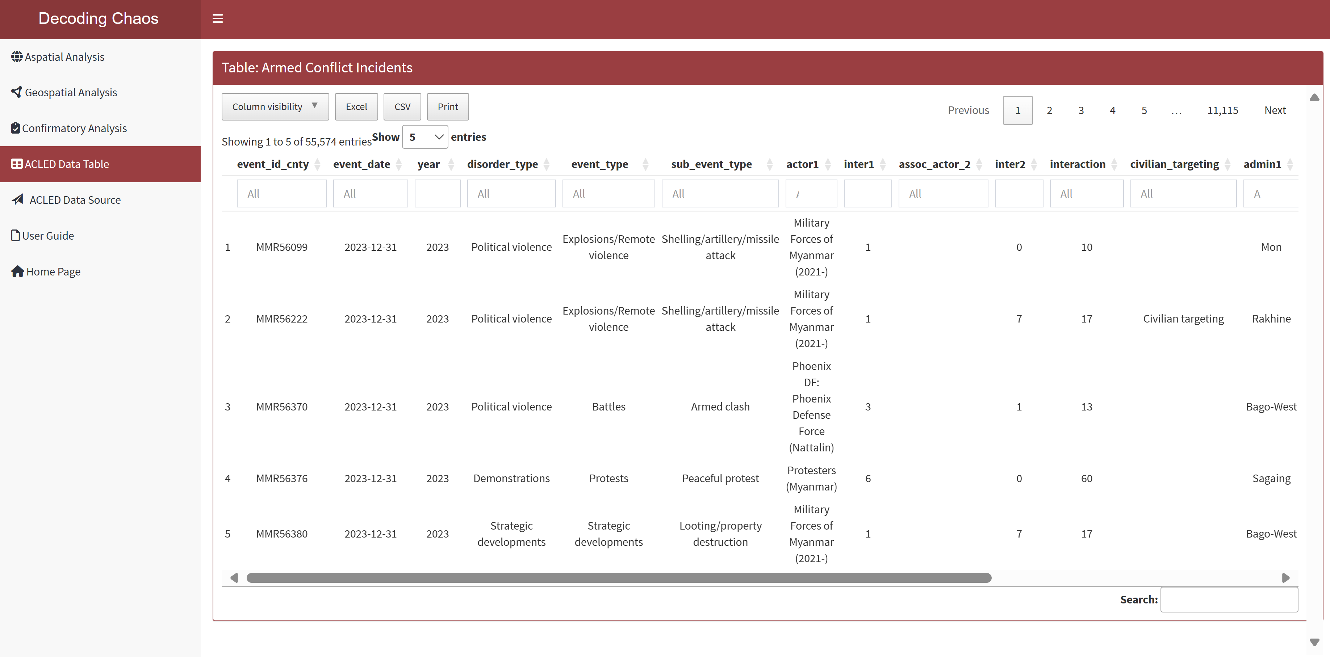
ACLED Data Table
This page displays an interactive datatable used for the project for users who prefer to navigate the raw dataset.
Data Table: Users can make use of the interactive table to perform the following:
Users can select the columns that they are interested to view and hide the rest.
Users can download/ print dataset.
Users can specify the number of entries to display.
Users can search for a particular value or classification via the search box.
Users can sort each variable in ascending or descending order.
1
a
b
c
d
e

